Slide 1
Final Review
Notes:
47
9

Slide 2
Ch11 Regression and correlation
Linear regression
  Model, interpretation.
  Model Coefficient calculation.
    b = L_{xy} / L_{xx} (slope), b₀ = Y – b x
  Assumption, goodness-of-fit, validity.
  Independent error, Gaussian dist. Const. var.
  Test and inference (t-test).
  Multiple regression. F-test vs T-test.
Pearson correlation
  Interpretation and inference
  T-test and Fisher’s z-test (transformation).
  1. t = r (n-2)^{1/2} /(1-r²)^{1/2} ~ t _{n-2}
  2. Z = ½ ln [(1+r) / (1-r)] ~ Normal mean=Z(r₀) and var =1/(n-3)
-
-

Slide 3
Learning Objectives
Describe the Linear Regression Model
State the Regression Modeling Steps
Explain Ordinary Least Squares
Compute Regression Coefficients
Understand and check model assumptions
Predict Response Variable
Comments of SAS Output
Notes:
As a result of this class, you will be able to...

Slide 4
Learning Objectives…
Correlation Models
Link between a correlation model and a regression model (one indep. Var): b = rS_{y}/S_{x,} and S_{y}² = L_{yy} /(n-1)
Test of coefficient of Correlation

Slide 5
ANOVA
Continuous response, categorical explanatory (indep) var.
Assumption. (Gauss-Markov condition).
Decomposition SS
SS _{total} = SS _{trt} + SS _{error}
or SS _{total} = SS _{trt} + SS_{blk} + SS _{error}
or SS _{total} = SS_{A} + SS_{B} + SS_{AB} + SS _{error}
Estimation vs Prediction (diff. var.)

Slide 6
Multiple comparison
Contrast for multiple levels of var.
construct contrast according to aim.
Adjustment for multiple comparison
LSD, Bonferroni, Sheffe.

Slide 7
Ch 9 Non-parametric tests
Mainly interested in ranking (distribution)
Normality of data may be violated.
Sign test, rank sum test, signed-rank test,
Kruskal-Wallis test

Slide 8
Summary
Nonparametric | Parametric
Sign Rank test | One sample t-test
Wilcoxon Rank – Sum test (Mann-Whitney U test) | Two sample t-test
Wilcoxon Signed-Rank test | Two paired sample t-test
Kruskal-Wallis test | Multiple sample test.
Notes:
As a result of this class, you will be able to ...

Slide 9
Ch 10 Categorical Data Analysis

Slide 10
Learning Objectives
Comparison of binomial proportion using Z and χ² Test.
Explain χ² Test for Independence of 2 variables
Explain The Fisher’s test for independence
McNemar’s tests for correlated data
Kappa Statistic
Use of SAS Proc FREQ
Notes:
As a result of this class, you will be able to ...

Slide 11
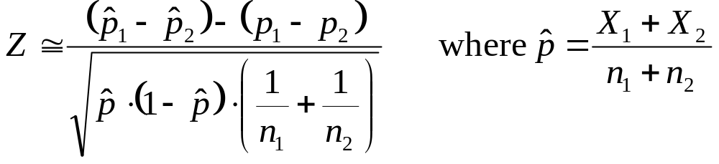
Z Test for Difference in Two Proportions
1. Assumptions
  Populations Are Independent
  Populations Follow Binomial Distribution
  Normal Approximation Can Be Used for large samples (All Expected Counts ≥ 5)
Z-Test Statistic for Two Proportions

Slide 12
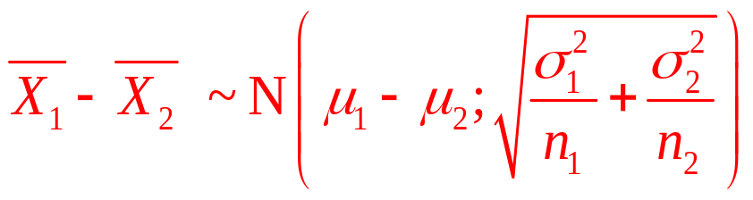
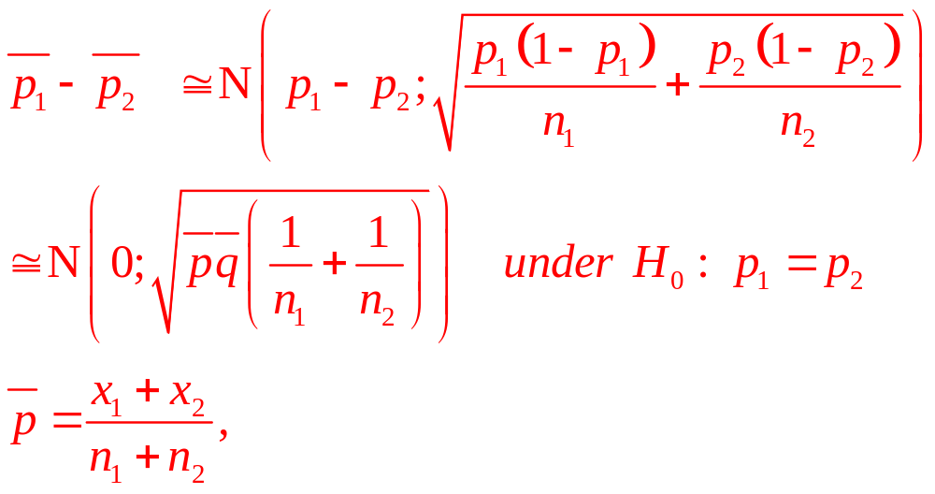
Sample Distribution for Difference Between Proportions

Slide 13
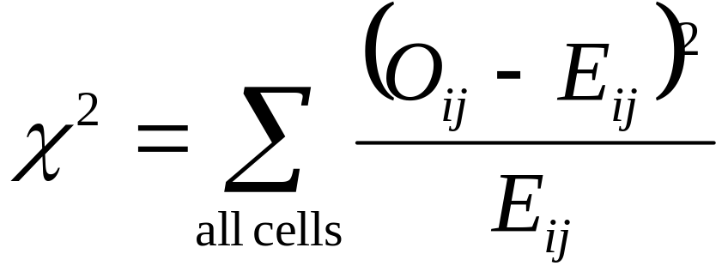
χ² Test of Independence
Hypotheses & Statistic
1. Hypotheses
  H₀: Variables Are Independent
  H_{a}: Variables Are Related (Dependent)
Test Statistic
Degrees of Freedom: (r - 1)(c - 1)
O: Observed count
E: Expected count
r Rows & C Columns
Notes:
41

Slide 14
Fisher’s Exact Test
a b M1
c d M2
N1 N2 N
Hypergeometric distribution
Example: 2x2 table (cell counts a, b, c, d).
Assuming fixed marginal totals:
M1 = a+b, M2 = c+d, N1 = a+c, N2 = b+d.
for convenience assume N1<N2, M1<M2.
possible value of a are: 0, 1, …min(M1,N1).
Probability distribution of cell count a follows a hypergeometric distribution:
N = a + b + c + d = N1 + N2 = M1 + M2
  Pr (x=a) = N1! N2! M1! M2! / [N! a! b! c! d!]
  Mean (x) = M1 N1 / N
  Var (x) = M1 M2 N1 N2 / [N² (N-1)]

Slide 15
Fisher’s Exact Test
Fisher exact test is based on hypergeometric distr.
Probability of observing this specific table given fixed marginal totals is
Pr (a=3,b=7, c=5, d=10) = 10!15!8!17!/[25!3!7!5!10!]
= 0.3332
Note the above is not the p-value. Why?
Not the accumulative probability, or not the tail probability.
Notice range of a: [0, min(M1, N1)] for M1<M2 and N1<N2
Tail prob = sum of all values (a = 3, 2, 1, 0).

Slide 16
Kappa ( κ )
Measures of Association
Cohen’s Kappa ( κ )
  Cohen’s κ measures the agreement between two variables and is defined by
p_{o} - p_{e}
κ =
1 - p_{e}
Kappa >.75 excellent reproducibility;
[.4, .75] good reproducibility;
<.4 marginal reproducibility.

Slide 17
McNemar’s Test for Correlated (Dependent) Proportions
H₀: π₁ = π₂ : discordant probabilities.
H_{a}: π₁ ≠ π₂
Test Statistic: Chi-squares with df = 1.
 { |B – C| - 1 }²
Χ ² =
B + C

Slide 18
Chapter 13
Design and Analysis Techniques for Epidemiologic Studies

Slide 19
Learning Objectives
Define study designs
Measures of effects for categorical data
Confounders and effects modifications
Stratified analysis (Mantel Haenszel statistic, multiple logistic regression)
Use of SAS Proc FREQ and Proc Logistic
Notes:
As a result of this class, you will be able to ...

Slide 20
Experimental Study
Randomization protects against bias in assignment to groups.
Blinding protects against bias in outcome assessment or measurement.
Control for (major) sources of variability, although not necessarily reflecting real life conditions
Expensive in terms of time and money

Slide 21
Observational Study most likely used in Epidemiology
Types of study
  Cross-sectional study
  Both expos & outcome random;
  Case-control study (retrospective)
  Random expos, fixed outcome;
  Cohort study (Prospective)
  Fixed expos, random outcome.

Slide 22
Measures of effects
Depends on study design
  Prospective study: Incidence of disease (risk difference, relative risk, odds ratio of disease)
  Cross-sectional: Prevalence of disease (risk difference, relative risk, odds ratio of disease)
  Case-cohort: study of exposure (odds ratio of exposure)

Slide 23
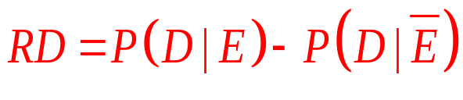
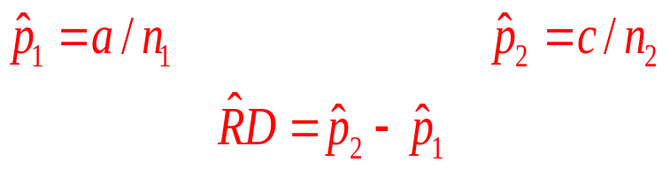
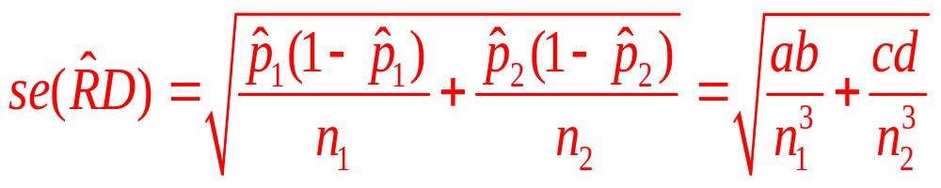
Risk difference
Only for cross-sectional and cohort studies Measured the attributable risk due to exposure

Slide 24
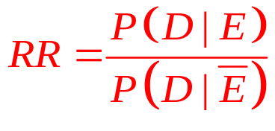
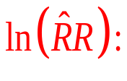
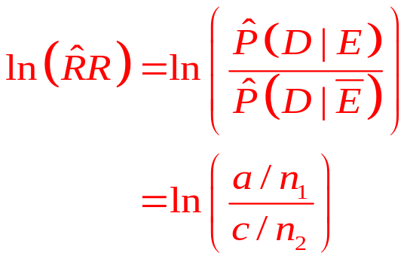
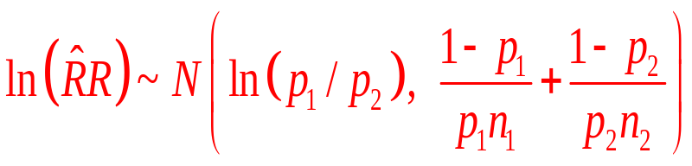
Relative Risk
Only for cross-sectional and cohort studies: Ratio of the probability that the outcome characteristic is present for one group, relative to the other
The range of RR is [0, ∞). By taking the logarithm, we have (- ∞, +∞) as the range for ln(RR) and a better approximation to normality for the estimated

Slide 25
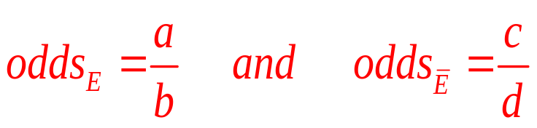
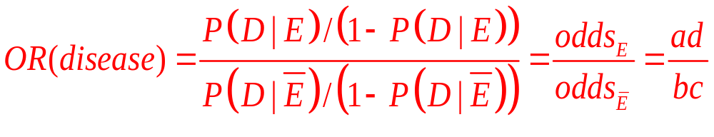
Odds Ratio - Disease
Odds ratio is the odds of the event for exposed divided by the odds of the event for unexposed
Sample odds of the outcome for each group:

Slide 26
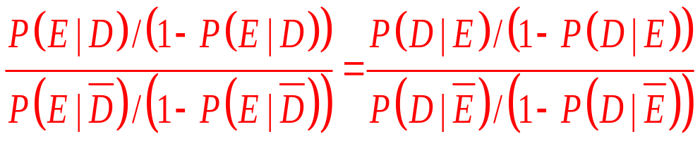
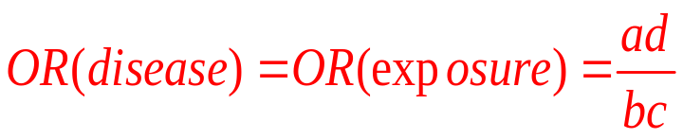
Odds Ratio-Exposure
we fixed the number of cases and controls then ascertained exposure status. The relative risk is therefore not estimable from these data alone. Instead of the relative risk we can estimate the exposure OR which Cornfield (1951) showed equivalent to the disease OR:
In other words, the odds ratio can be estimated regardless of the sampling scheme.

Slide 27
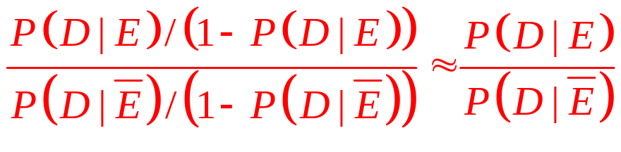
Odds Ratio-Relative risk
For rare diseases, the disease odds ratio approximates the relative risk:
Since with case-control data we are able to effectively estimate the exposure odds ratio we are then able to equivalently estimate the disease odds ratio which for rare diseases approximates the relative risk.

Slide 28
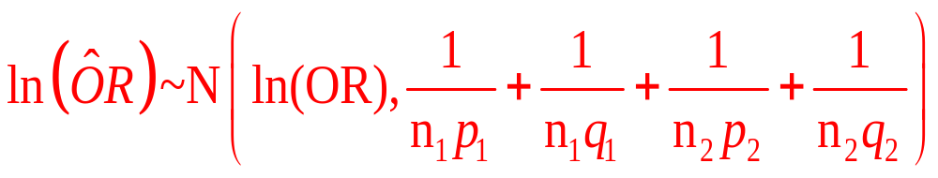
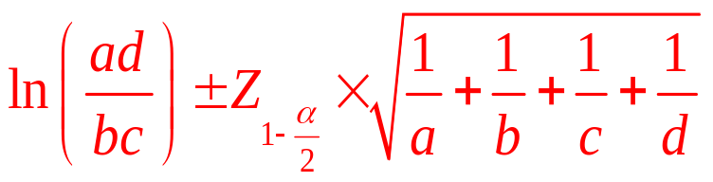
Odds Ratio
The odds ratio has [0, ∞) as its range. The log odds ratio has (- ∞, +∞) as its range and the normal approximation is better as an approximation to the estimated log odds ratio.
Confidence intervals are based upon:
Therefore, a (1 - α) confidence interval for the odds ratio is given by exponentiating the lower and upper bounds.

Slide 29
Summary
RD = p₁ - p₂ = risk difference (null: RD = 0)
  also known as attributable risk or excess risk
  measures absolute effect – the proportion of cases among the exposed that can be attributed to exposure
RR = p₁/ p₂ = relative risk (null: RR = 1)
  measures relative effect of exposure
  bounded above by 1/p₂
OR = [p₁(1-p₂)]/[ p₂ (1-p₁)] = odds ratio (null: OR = 1)
  range is 0 to ∞
  approximates RR for rare events
  invariant of switching rows and cols
  key parameter in logistic regression
Notes:
If switch only row or only col in OR, then new OR is 1/old OR
Typical null: RD=0, RR=1, OR=1

Slide 30
Effect modifier
Variation in the magnitude of measure of effect across levels of a third variable.
Effect modification is not a bias but useful information
Happens when RR or OR
is different between strata
(subgroups of population)

Slide 31
Confounding
Distortion of measure of effect because of a third factor
Should be prevented or Needs to be controlled for

Slide 32
Confounding
Exposure
Outcome
Third variable
Be associated with exposure - without being the consequence of exposure
Be associated with outcome - independently of exposure

Slide 33
Confounding and Control
Positive confounding
- positively or negatively related to both
the disease and exposure
Negative confounding
- positively related to disease but is
negatively related to exposure or the
reverse
Prevention (Design Stage)
Restriction to one stratum or Matching
Control (Analysis Stage)
Stratified analysis – Mantel Haenszel
Multivariable analysis – logistic regression.

Slide 34
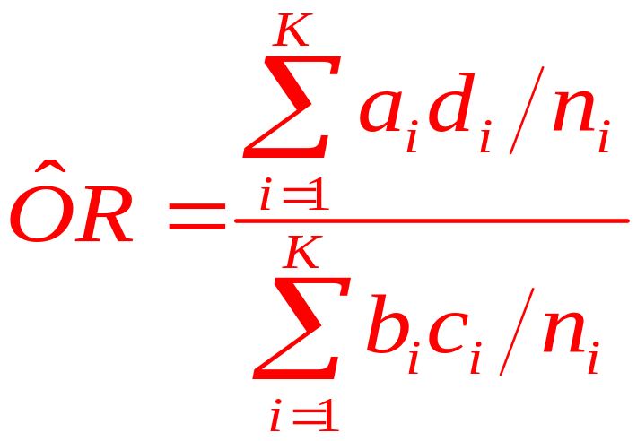
Mantel Haenszel Methods common odds ratio
The Mantel-Haenszel estimate of the odds ratio assumes there is a common odds ratio:
OR_{pool} = OR₁ = OR₂ = … = OR_{K}
To estimate the common odds ratio we take a weighted average of the stratum-specific odds ratios:
MH estimate:

Slide 35
Mantel Haenszel Methods
(2) Test of common odds ratio
H_{o}: common OR is 1.0 vs. H_{a}: common OR ≠ 1.0
- A standard error is available for the MH common odds
- Standard CI intervals and test statistics are based on the standard normal distribution.
(3) Test of effect modification (heterogeneity, interaction)
H_{o}: OR₁ = OR₂ = … = OR_{K}
H_{a}: not all stratum-specific OR’s are equal
Breslow-Day (SAS) homogeneity test can be used

Slide 36
Multiple Logistic Regression

Slide 37
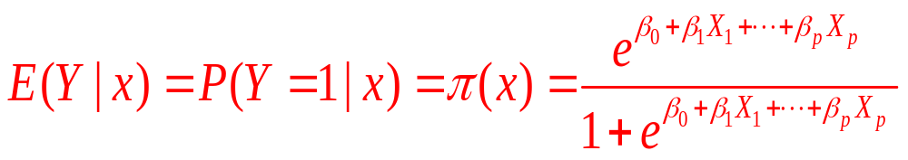
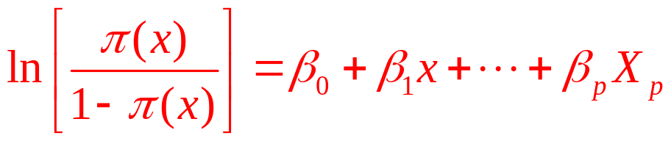
Multiple Logistic Regression-Formulation
The relationship between π and x is S shaped
The logit (log-odds) transformation (link function)

Slide 38
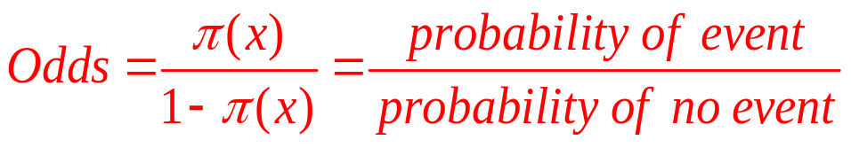
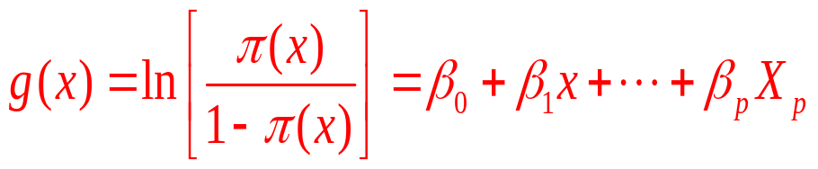
Interpretation of the parameters
If π is the probability of an event and O is the odds for that event then
The link function in logistic regression gives the log-odds

